Slide 1




INFORMATION
TECHNOLOGY
INSTITUTE
وزارة الاتصـــــــــالات
وتكنولوجيا المعلومات
BANKING
SYSTEM
Track : Business Intelligence

Slide 2








OUR TEAM
Ahmed Elbermawy
Akmal Eleraky
Mohamed Roushdy
Mario Farouk
Mohamed Taher
Ahmed El saghir

Slide 3

OVERVIEW
01
02
03
OLTP System
ETL
Data Warehouse
04
05
06
Power Bi Visualisation
Tableau Visualisation
SSAS & SSRS

Slide 4
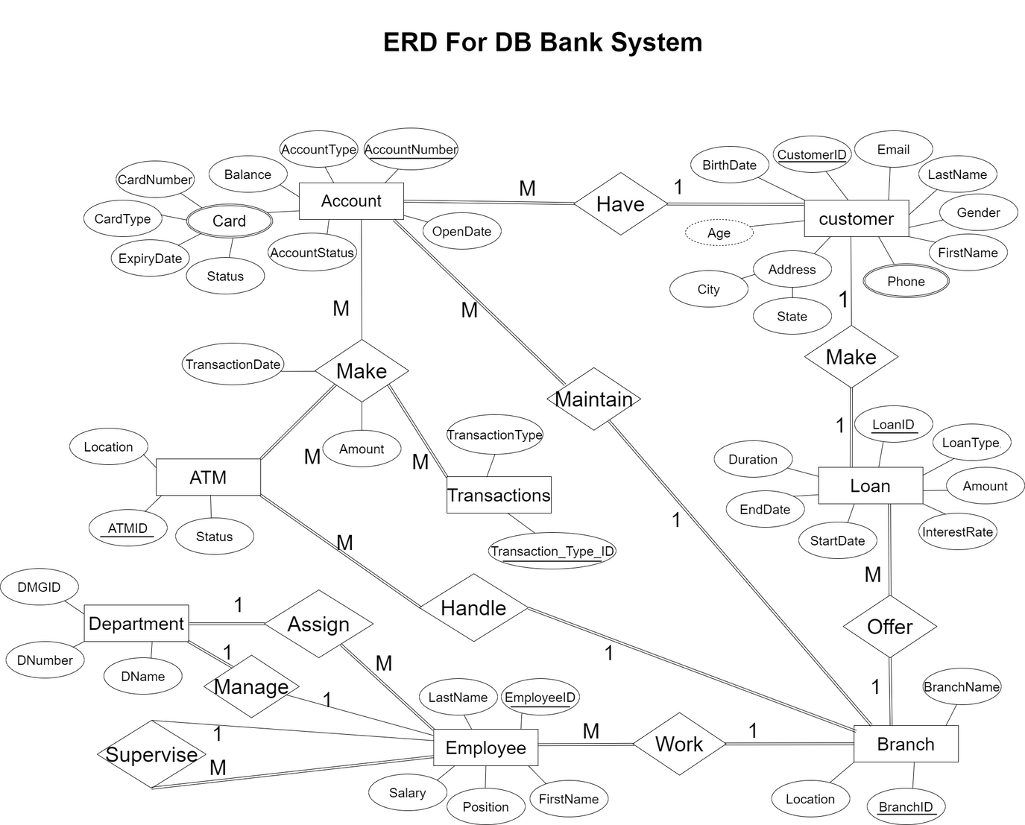
ERD Diagram
Defined Data Relationships between Entity.

Slide 5
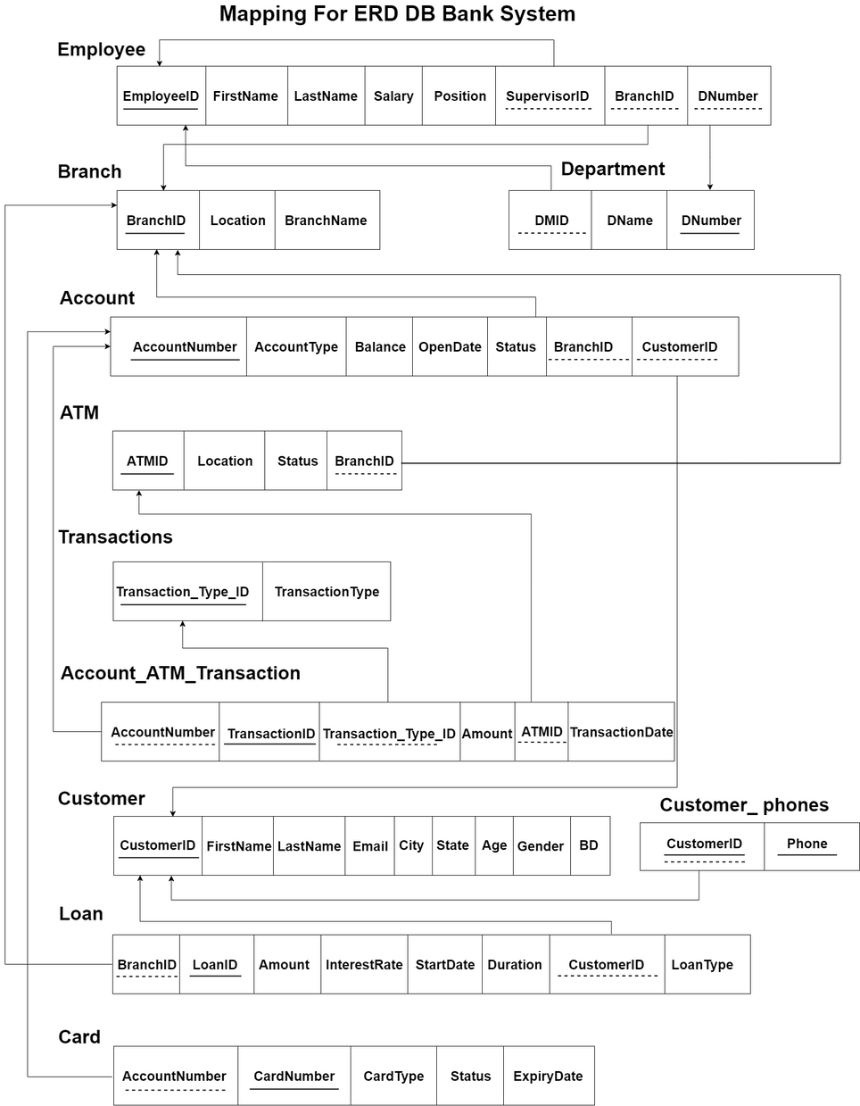
Mapping Schema
Ensures Data flow.

Slide 6
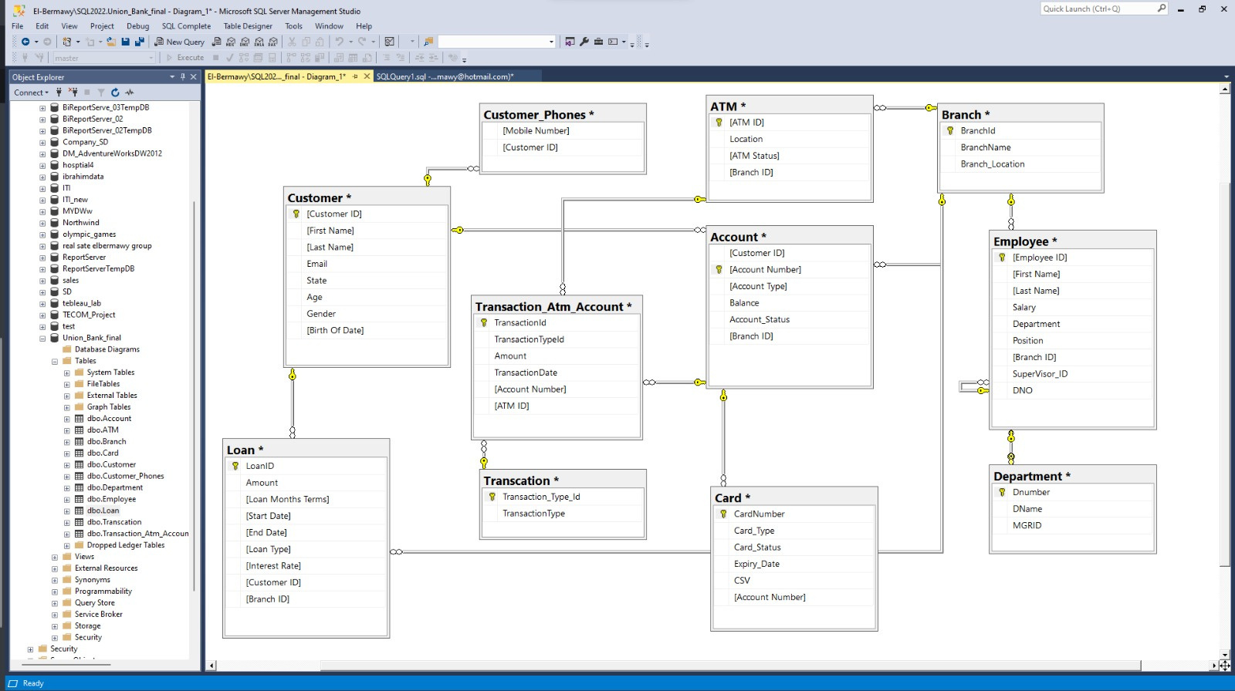
OLTP Schema
database system designed to handle and manage real-time transactional workloads.

Slide 7
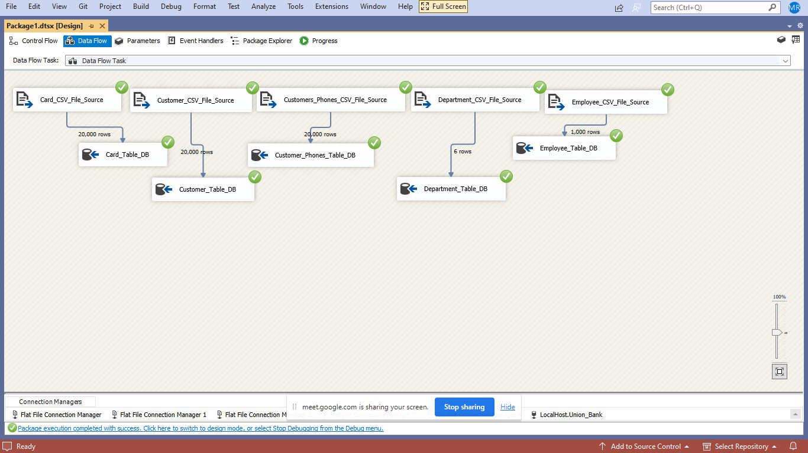
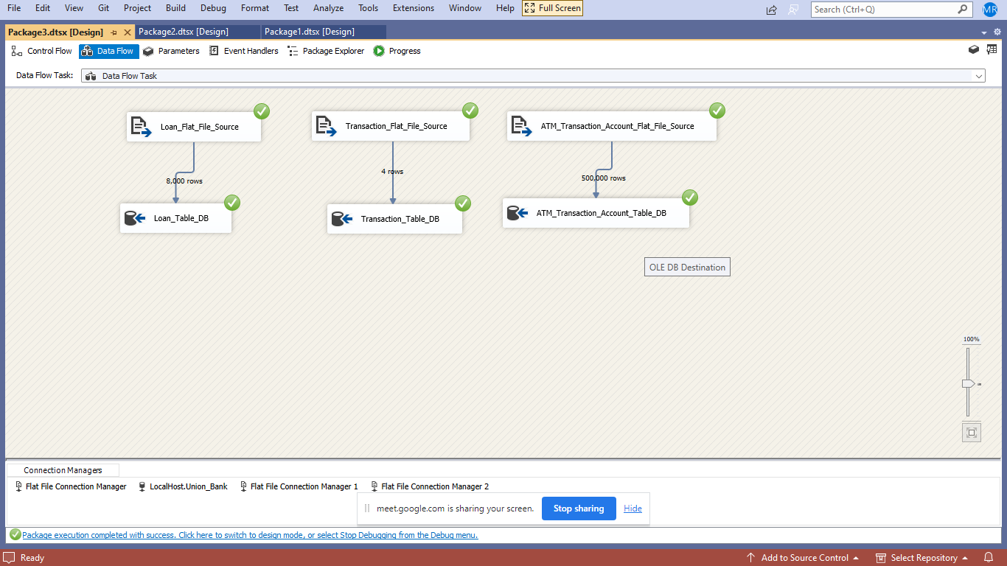
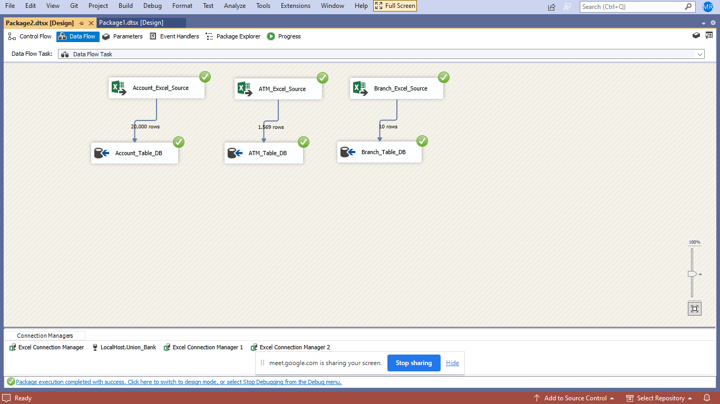
ETL
SSIS Manage Extract, Transform, and Load data from different resources.

Slide 8
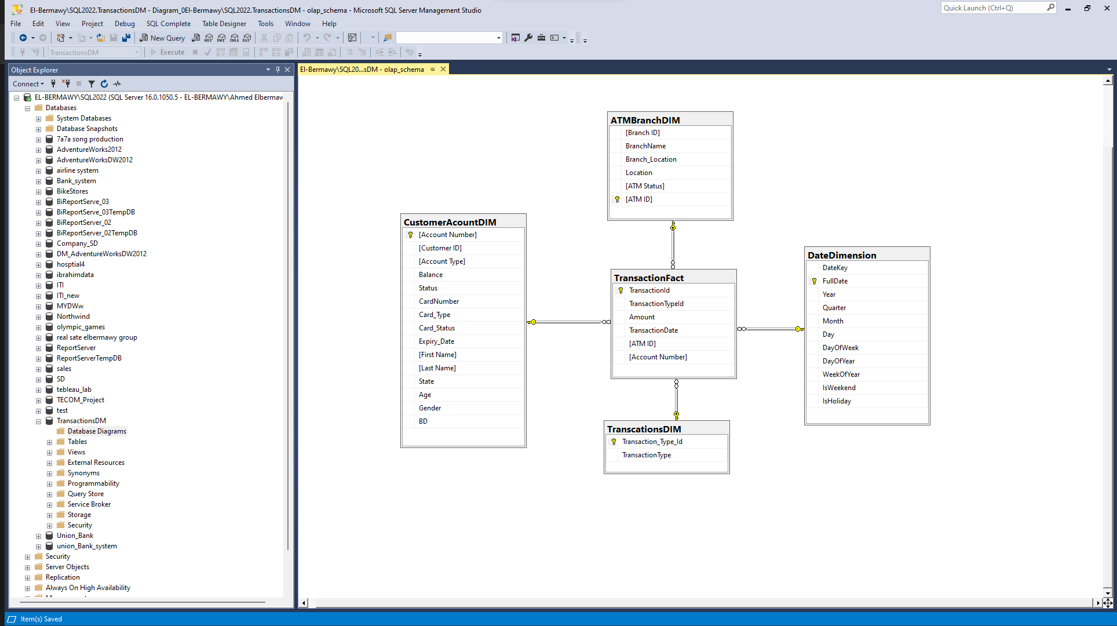
OLAP Schema DWH
Data warehousing centralizes data .
(Star Schema)

Slide 9
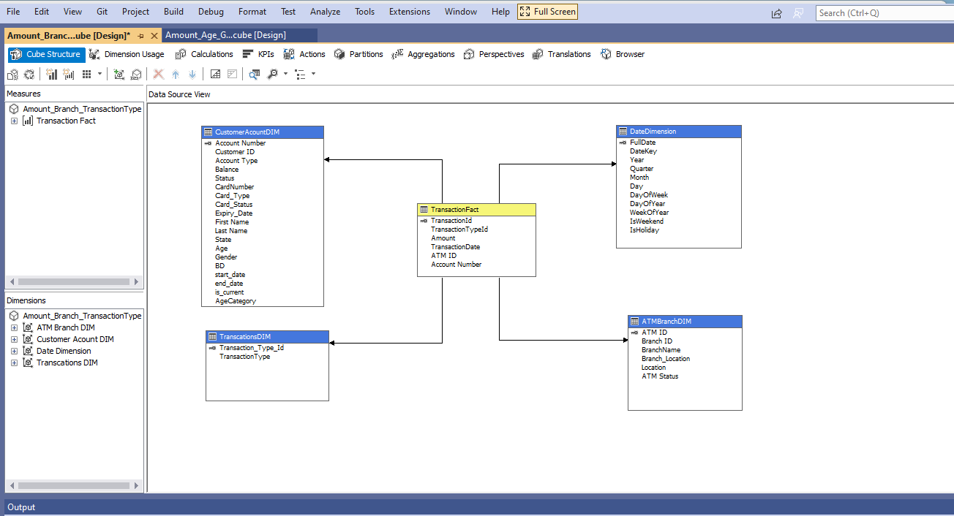
SSAS
Enable Multidimensional analysis with Cubes.

Slide 10
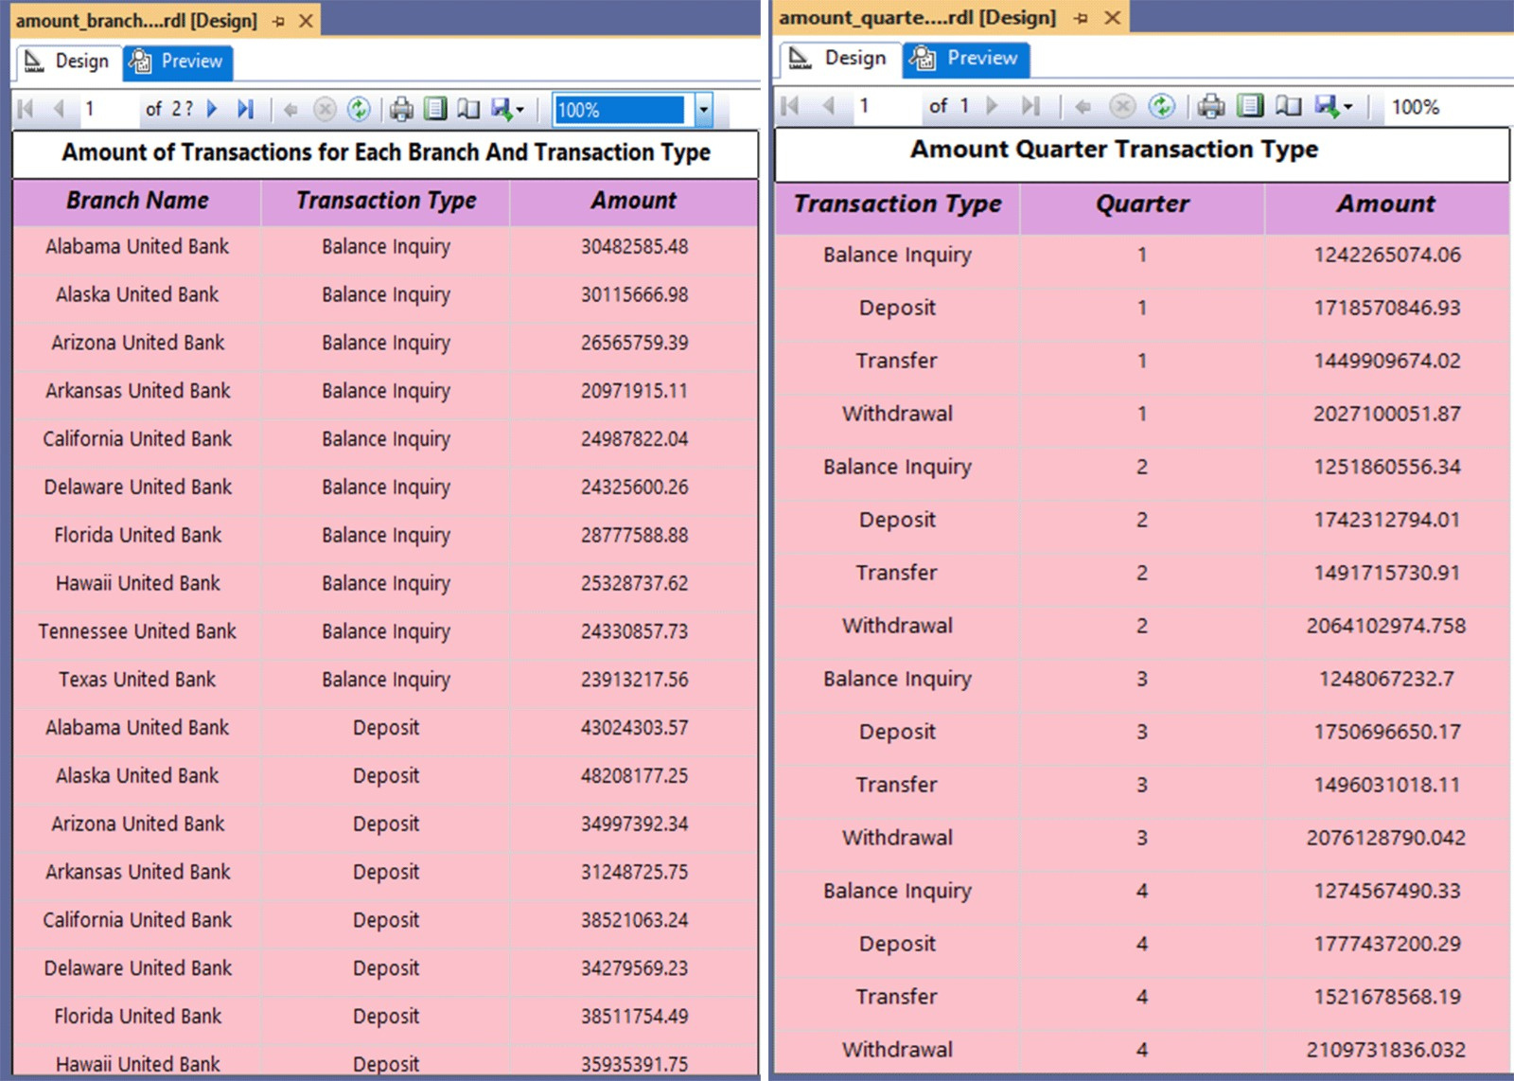
SSRS
SSRS produces reports .

Slide 11
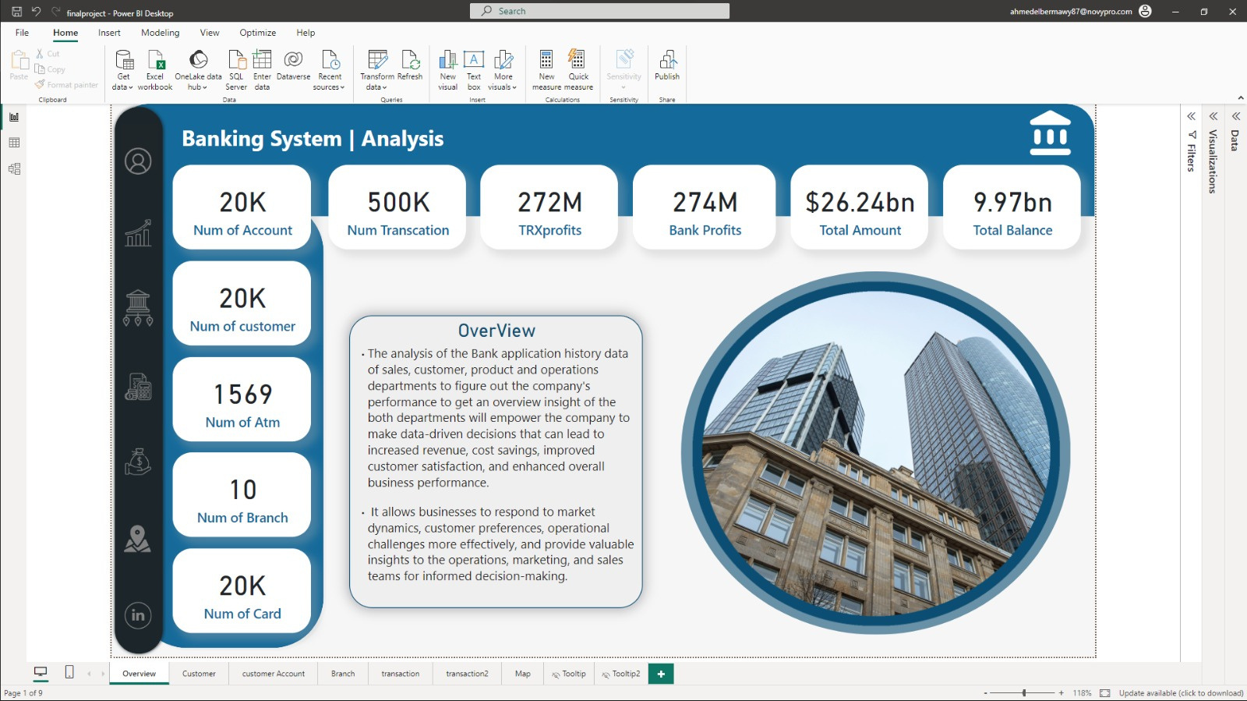
OverView
Visualize Using Power Bi Tool.

Slide 12
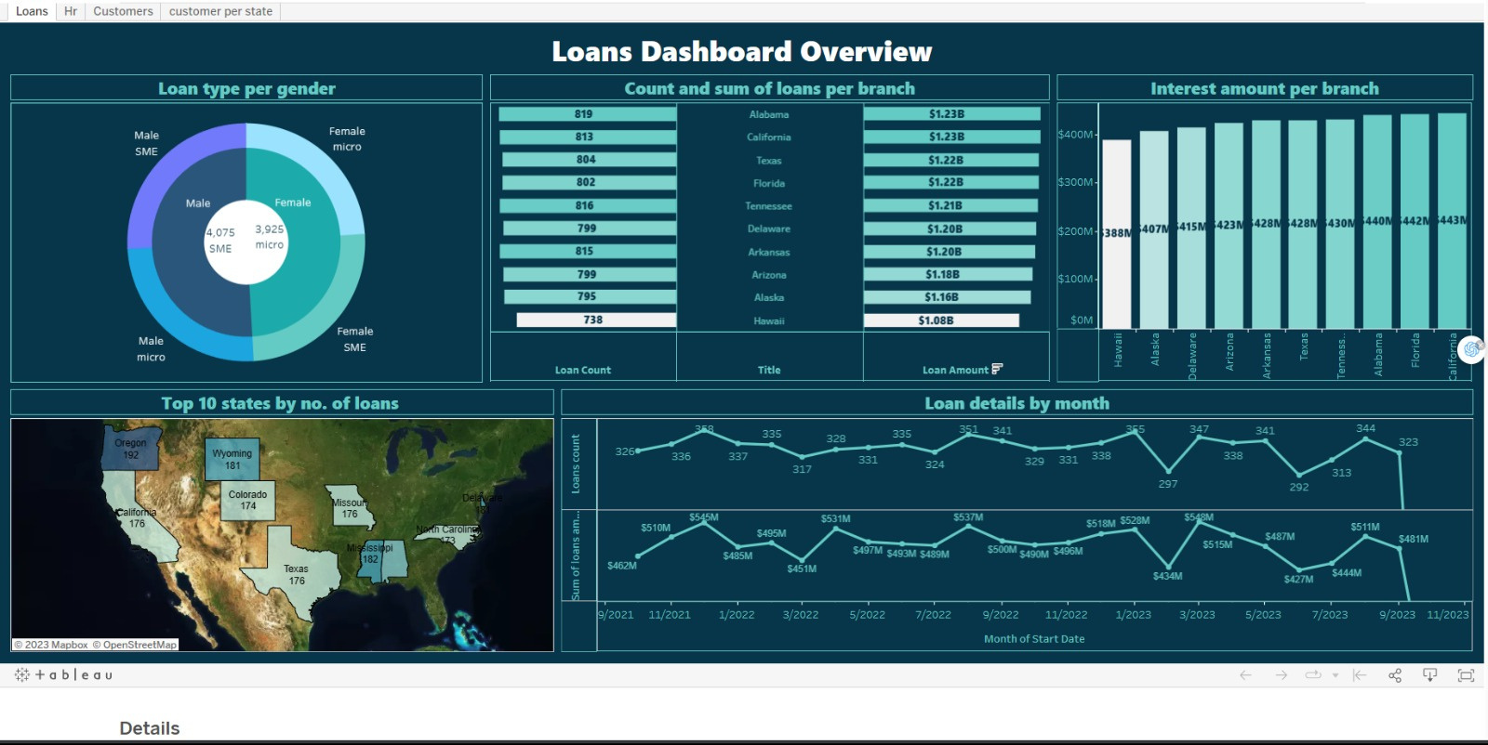
OverView
Visualize Using Tableau Tool.

Slide 13


INFORMATION
TECHNOLOGY
INSTITUTE
وزارة الاتصـــــــــالات
وتكنولوجيا المعلومات
Thank's For Watching
Connect with us.
Ahmed Elbermawy/
Akmal Eleraky/
Mario Farouk/
Mohamed Roushdy/
Ahmed El saghir/
Mohamed Taher/

